Slide 1
Claim Mirroring Workflow

Slide 2
Enter Method Claim
User will enter the entire Method Claim into word as normal.
Formatting and wording will be taken from this claim

Slide 3
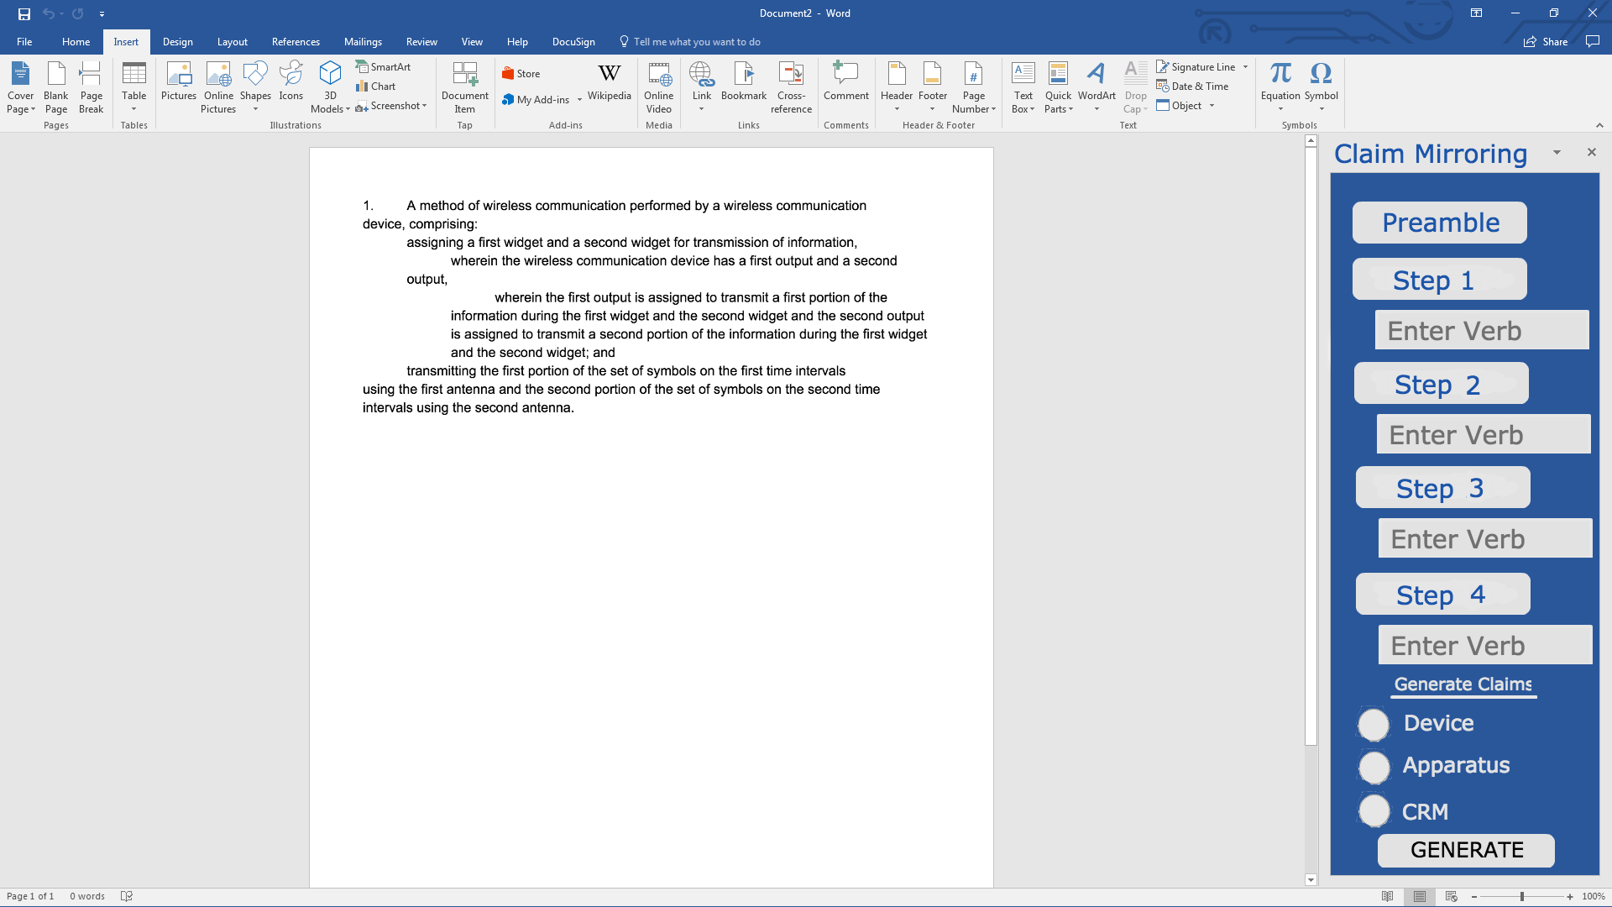
Preamble - Claim Mirroring
User will highlight their preamble then click the “Preamble” button highlighted below.

Slide 4
Steps – Claim Mirroring
The user will then highlight each step, being sure to include any spaces or tabs included, then click the “Step” button on next slide.
The user will also enter the verb that is needed for the other claims. (this is not optimal but will work for MVP)
This will store the formatting and text into the program so it can produce the other claims
The highlighting, clicking, and verb entry will have to be completed for each step in the claim

Slide 5
Steps – Claim Mirroring
The user would enter “assign” in this field

Slide 6
Generate Claims – Claim Mirroring
The user will check each claim type they would like to generate (see on next slide)
Once claims have been selected click “Generate”.
It will produce the claims with the agreed upon language and format (discussed further in document)

Slide 7
Generate Claims – Claim Mirroring

Slide 8
Device Claim Details
Preamble: A device for wireless communication, comprising: memory; and one or more processors coupled to the memory, the memory and the one or more processors configured to:
Steps: These will mirror the exact same formatting as the highlighted text except for the following changes:
Erase the first word and replace it with the entered word on the add-in

Slide 9
Apparatus Claim Details
Preamble: An apparatus for wireless communication, comprising:
Steps: These will mirror the exact same formatting as the highlighted text except for the following changes:
Add the text “means for” before each step

Slide 10
CRM Claim Details
Preamble: A non-transitory computer-readable medium storing one or more instructions for wireless communication, the one or more instructions comprising: one or more instructions that, when executed by one or more processors of a device, cause the one or more processors to:
Steps: These will mirror the exact same formatting as the highlighted text except for the following changes:
Erase the first word and replace it with the entered word on the add-in

Slide 11
Placing Claims in Document
Once the generate button has been clicked, the claims will be placed at the end of the document
The ordering will be Device, Apparatus, then CRM

Slide 12
Potential Changes
Instead of entering the verb, can it be generated?

Slide 13
Not in Scope
Changing device name to apparatus
Dependent Claims

Slide 14
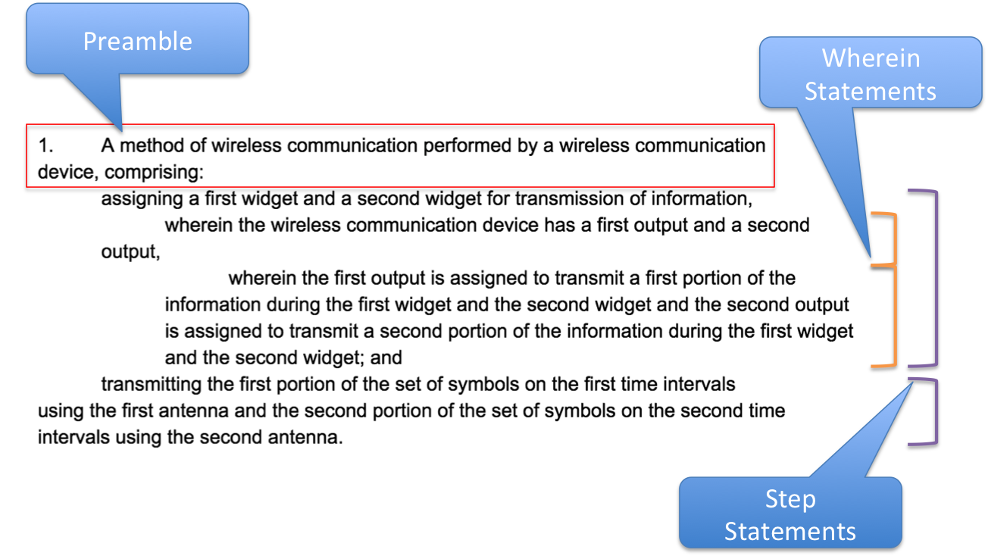
Claim Breakdown

